Slide 1

Employee Management System (EMS)
TEAM: QAFORCE
Project Description :
This EMS Project has the following features
Add Employee, Update , Delete , Read
Team Members
Talal
Mohammad
Abdullah
Yahya

Slide 2

Project – Introduction
Introduction:
EMPLOYEE MANAGEMENT SYSTEM
using Spring Boot and Rest

Slide 3
Project – Environment
Environment:
H2 database
Html
CSS
Windows and Mac
Chrome Browser

Slide 4
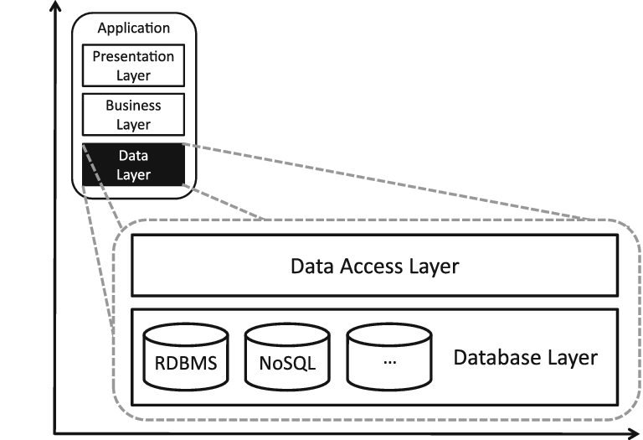
Project Data Access Layer
TEAM: QAFORCE

Slide 5
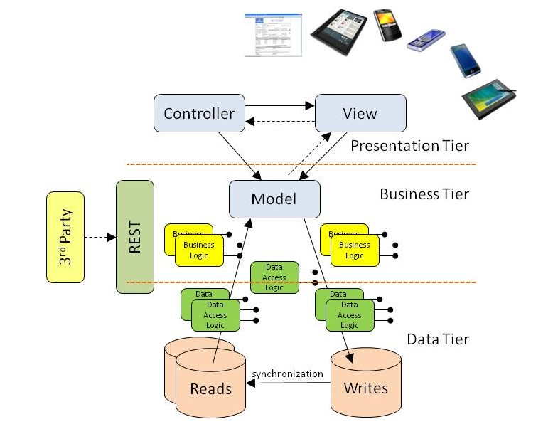
3-Tiers Architecture

Slide 6
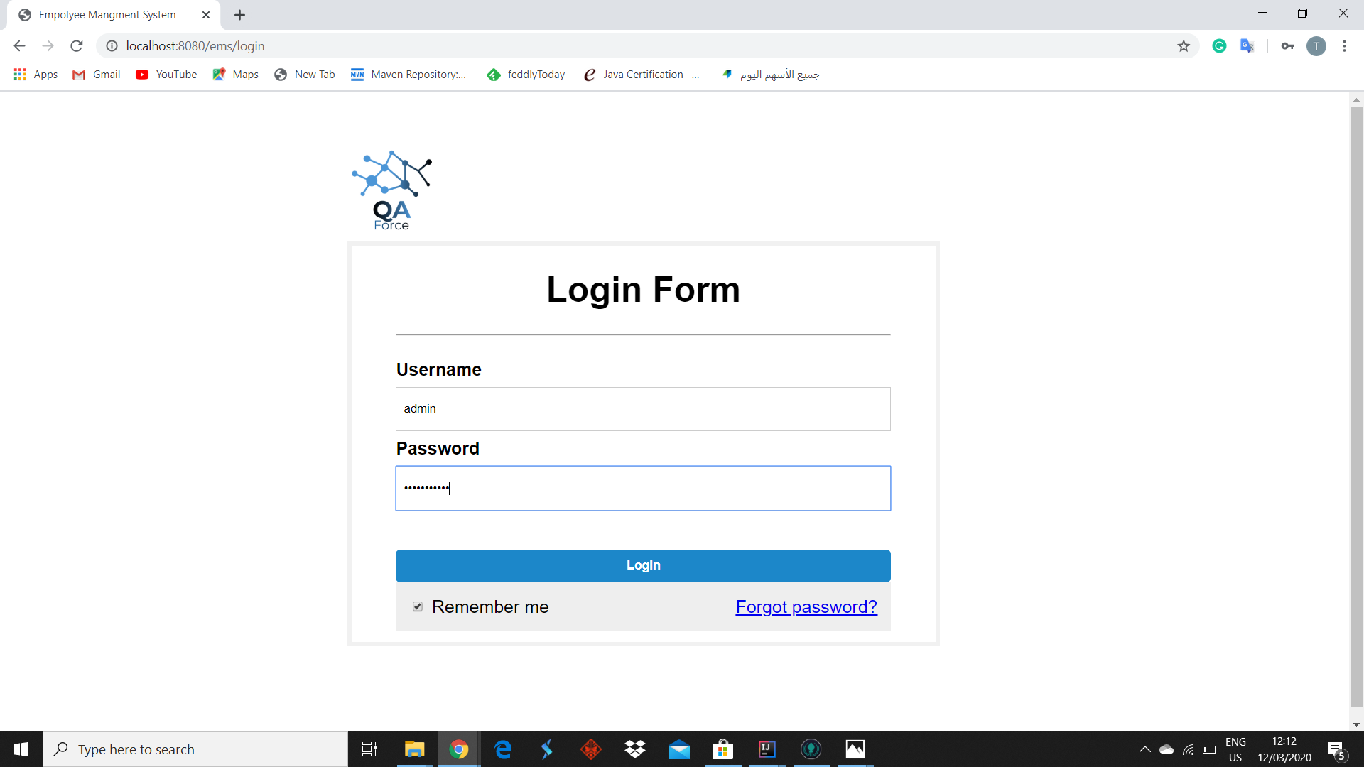

Project Pictures – Output Screenshot

Slide 7
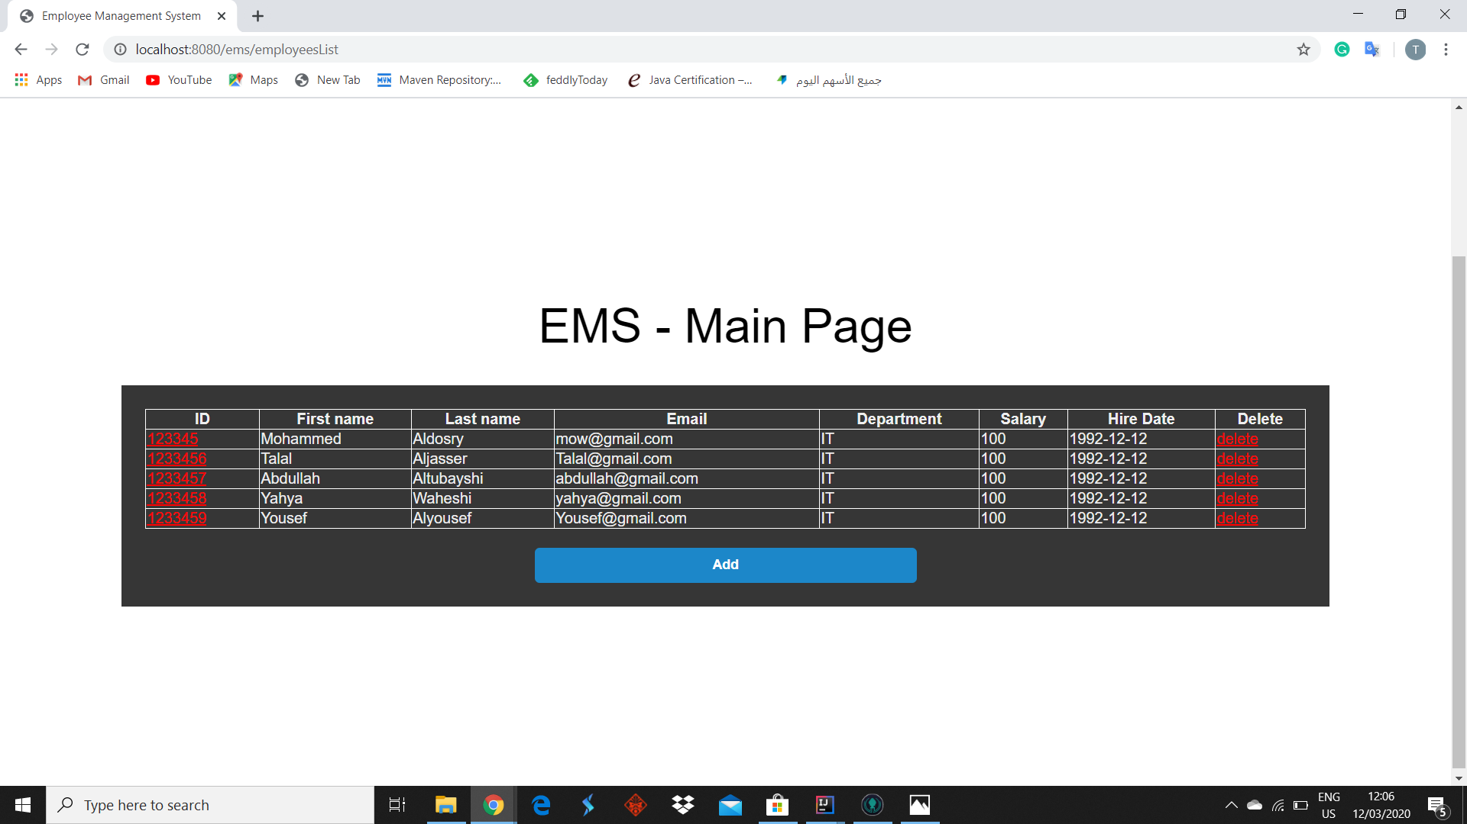
Project Pictures – Output Screenshot

Slide 8
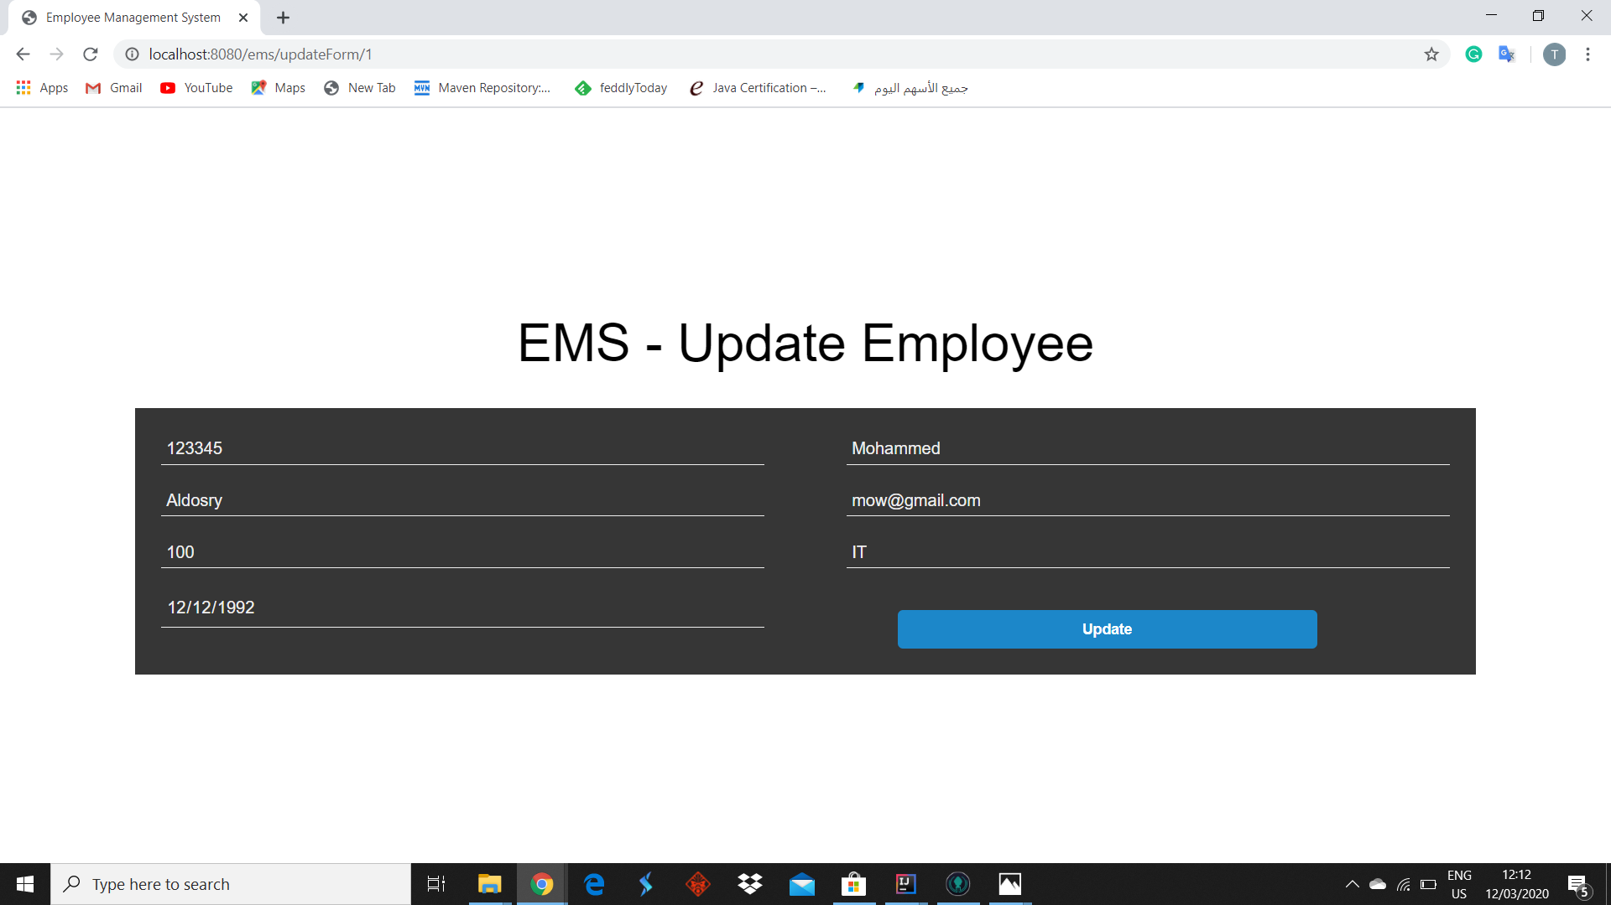
Project Pictures – Output Screenshot

Slide 9
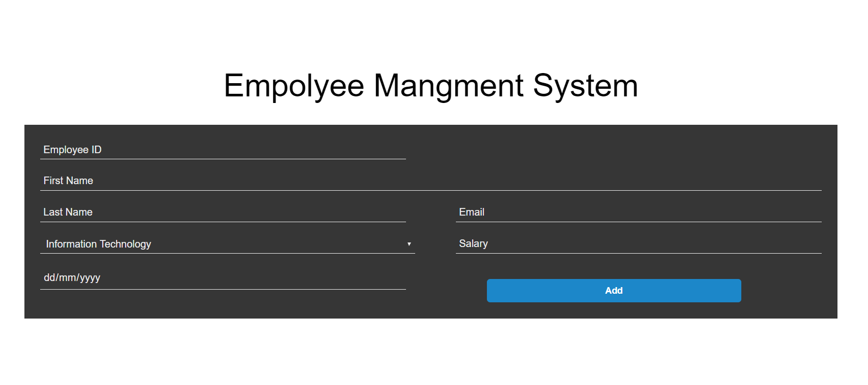
Project Pictures – Output Screenshot

Slide 10
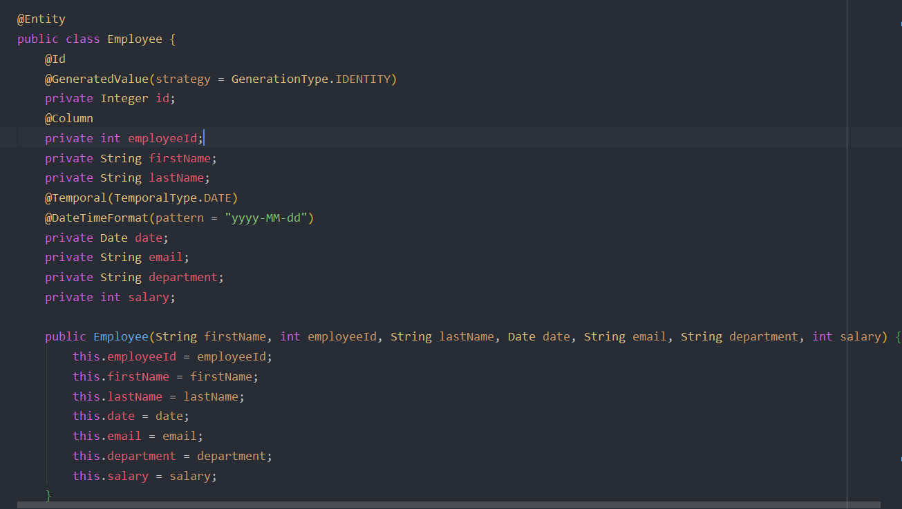
Project Pictures – Sample Source Code Screenshot

Slide 11
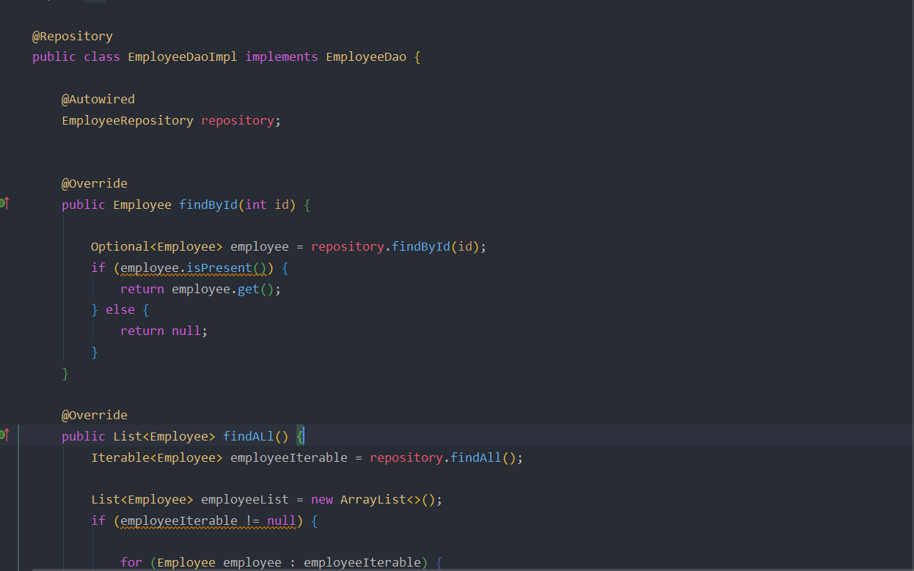
Project Pictures – Sample Source Code Screenshot

Slide 12
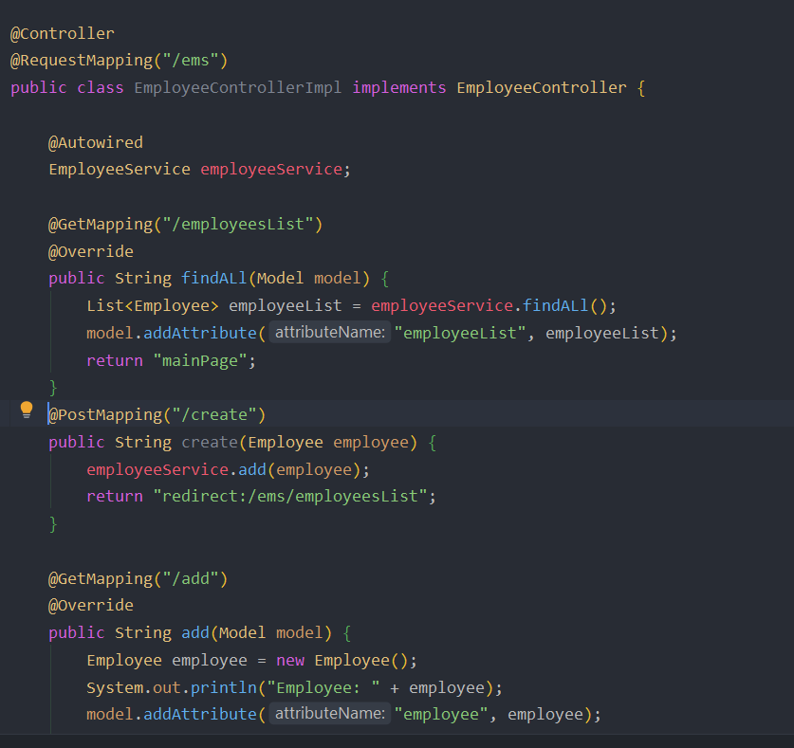
Project Pictures – Sample Source Code Screenshot

Slide 13
Source Code https://github.com/mickknutson/SITE_BOOTCAMP_QA/tree/master/StudentWork/Mohammed/SpringBoot/ems https://github.com/mickknutson/SITE_BOOTCAMP_QA/tree/master/StudentWork/Talal/SpringBoot/ems https://github.com/mickknutson/SITE_BOOTCAMP_QA/tree/master/StudentWork/Yahya https://github.com/mickknutson/SITE_BOOTCAMP_QA/tree/master/StudentWork/Abdullaht

Slide 14
Thank you all……………….

